Slide 1
Container orchestration

Slide 2

Everyone’s container journey starts with one container….

Slide 3
At first the growth is easy to handle….

Slide 4
But soon you have many applications, many instances…

Slide 5
And that is why there is container orchestration

Slide 6
What is container orchestration?
Management of the deployment, placement, and lifecycle of workload containers
Cluster management
Federates multiple hosts into one target
Scheduling
Distributes containers across nodes
Service discovery
Knows where the containers are located
Distributes client requests across the containers
Replication
Ensures the right number of nodes and containers
Health management
Replaces unhealthy containers and nodes
Container Orchestrator
Manager
Scheduler
Discovery DB
Image repository
Replicator
Node
Node
Node
Daemon
Daemon
Daemon
Containers
Containers
Containers

Slide 7
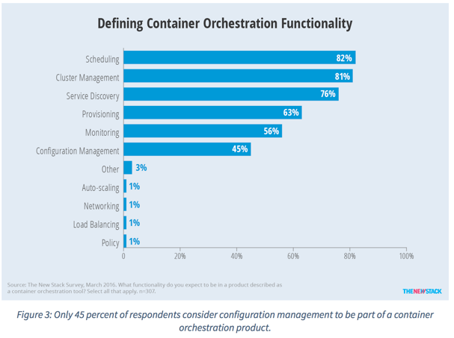
Container orchestration responsibilities
Container orchestration
Scheduling
Cluster management
Service discovery
Related functionality
Provisioning
Monitoring
Configuration management

Slide 8


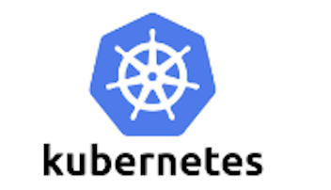





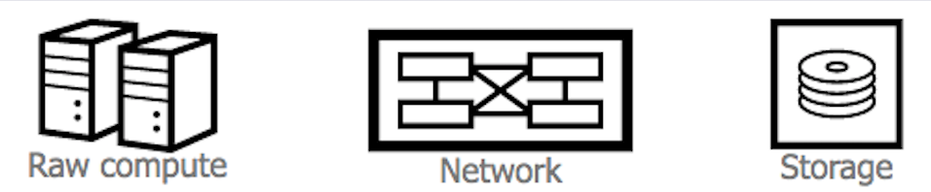
Container ecosystem layers
Layer 6
Development Workflow
Opinionated Containers
Layer 5
Orchestration/Scheduling
Service Model
Layer 4
Container Engine
Layer 3
Operating System
Layer 2
Virtual Infrastructure
Layer 1
Physical Infrastructure

